Slide 1
Prospective Los Angeles Neighborhoods

Slide 2
Virtual Work
COVID19 has changed changed the world in many ways, especially in regards to employment and type of employment.
Many tech companies have moved to more virtual roles, and some are predicting that many roles may stay virtual post-pandemic for several reasons (reduced cost of overhead, flexible work schedule, to name a few).
Young professionals moving to a new city may want to consider a neighborhood that has options to work from a coffee shop or café to get a change of scenery from working from home.
For this project, I am focusing on finding neighborhoods in Los Angeles that have coffee shops as their most common venue type.

Slide 3
Data
Neighborhood name, latitude and longitude of neighborhoods in Los Angeles obtained from http://wiki.stat.ucla.edu/socr/index.php/SOCR_Data_LA_Neighborhoods_Data
I will web scrape the table “Raw LA Neighborhoods Data” and delete unnecessary data (income, age, etc.)
Foursquare location data to get venue information for each neighborhood.

Slide 4
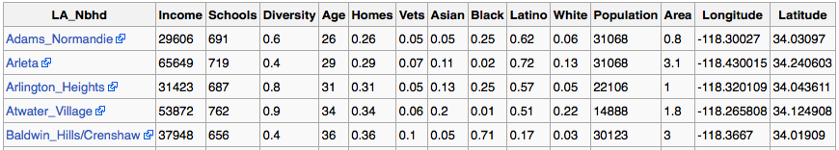
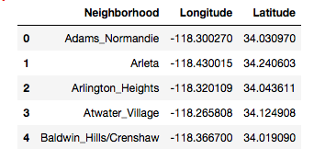
Cleaning Up Wiki Data:

Slide 5
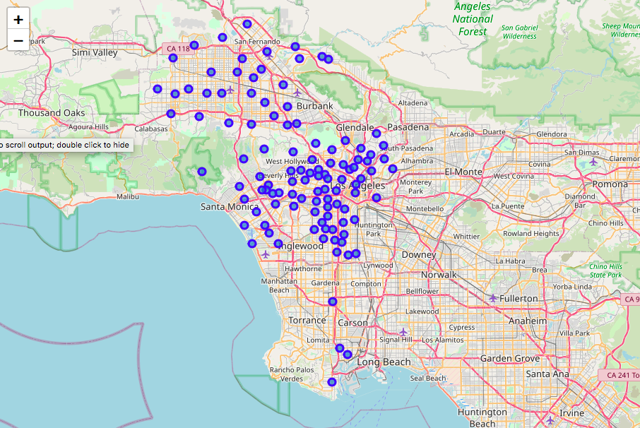
Map of Los Angeles
Map created using folium, geospy and cleaned up data from wiki table

Slide 6
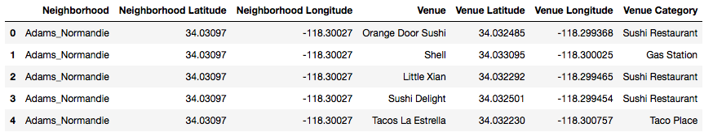
Los Angeles Venues and Categories

Slide 7
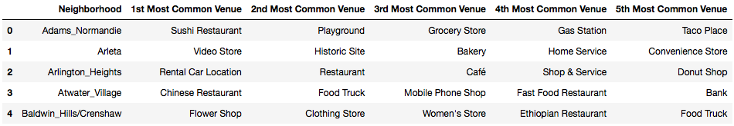
Los Angeles Neighborhoods with Top 5 Common Venues

Slide 8
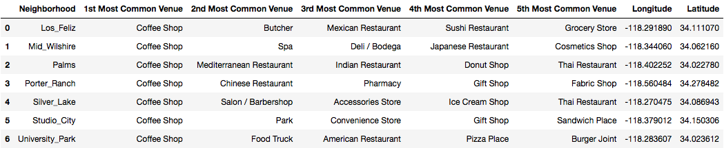
Final Neighborhoods
There were a total of seven neighborhoods found that had “Coffee Shop” as their top most common venue:

Slide 9
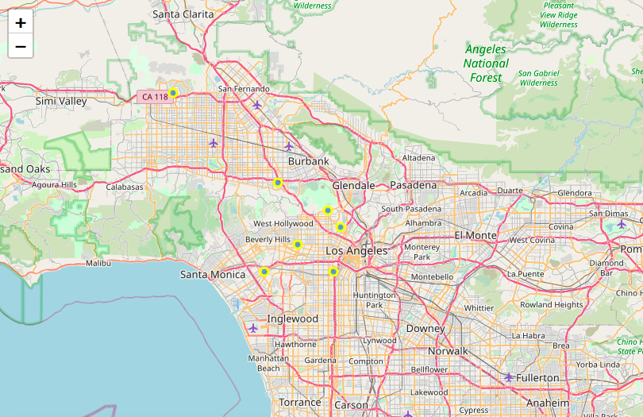
Visual Map of Prospective Neighborhoods

Slide 10
Conclusion
Although having coffee shops as the top venue in a neighborhood will not be the sole determining factor in selecting a neighborhood, this list is an initial list of neighborhoods for young, virtual professionals to consider if moving to Los Angeles.

